Slide 1
Leadership 101
How can I lead?

Slide 2
Course Overview
What is a Leader?
What makes a Leader?
How can I be a Leader?

Slide 3
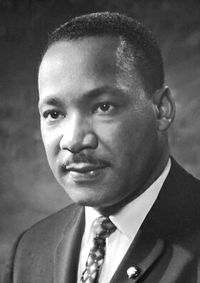
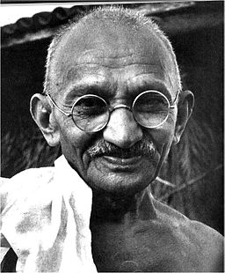
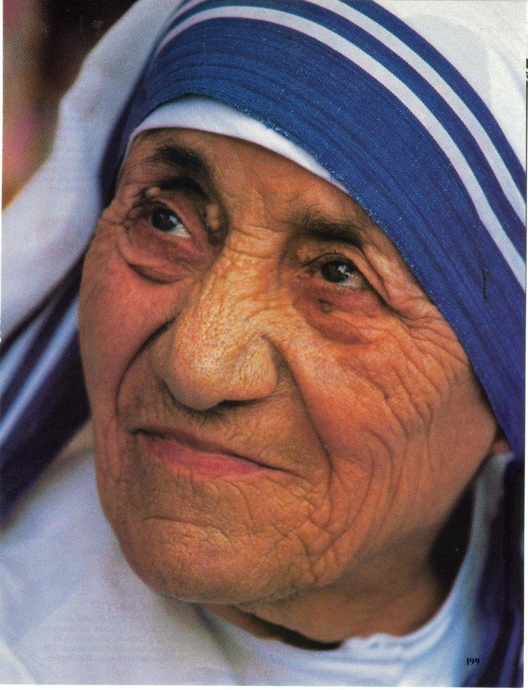
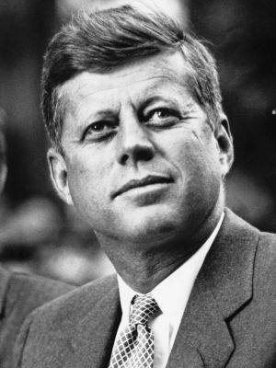
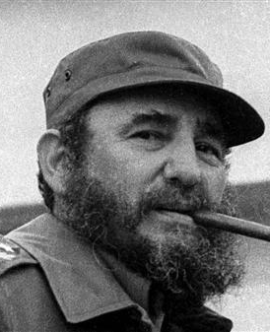
What is a Leader?
Leader – the person who leads a group, organization, or country
Leadership – the action of leading a group of people or an organization
The state or position of being a leader
The leaders of an organization or country
Who do you think of when you hear the word ‘Leader’?
What type of leader would you follow?

Slide 4
What makes a Leader?
Technical Knowledge and Capabilities – SME (Subject Matter Expert)
Effectively Communicate with others at all levels
Focused, Confident, Objective, Trustworthy
Manage Expectations
Lead by example

Slide 5
What Makes a Leader? 11 Qualities
Trustworthiness – one of the most important qualities, people want to work with someone they trust
Transparency – hand in hand with trust, no hidden agendas or reading between the lines
Focus and stability – keep calm under pressure… projects don’t go according to plan
Objectivity and Fairness – listen to all the sides
Confidence – confidence without arrogance
Lead by example – golden rule
Energy and Motivation – stay positive
Consistency and flexibility – consistent with communication, but adaptable to needs
Accessibility – be available
Clarity – taking something complex and making it simple
Respect – demonstrate respect to get respect

Slide 6
What makes a Leader? Leading Styles
Participative – invites input from team on all decisions
Authoritarian – dictates policies and procedures
Laissez-Faire – delegation, allowing team members to make decisions
Transformational – identifying needed change, making a plan, working with others to achieve the goal
Servant – making sure the highest priority needs are met, teach a person to fish
Transformational vs Servant – very similar, Transformational is more guided, where Servant puts more trust and freedom to the follower

Slide 7
How can I be a Leader?
Become a great communicator (written, verbal (face to face and on phone)
Break complex things down to simpler smaller things to help convey ideas
Listen before you speak
Think before you speak
Become a SME (subject matter expert)
Technologies working with
Methodologies working with
Yourself
Build your team – surround yourself with the resources to help you get where you want to be
Use the 11 Qualities of a Leader
Use the Leadership Styles

Slide 8
Summary
Defined what a Leader / Leadership is
11 Qualities of a Leader (not the only ones)
Leading Styles (again, not the only ones)

Slide 9
References
Transformational vs Servant Leadership https://www.regent.edu/acad/global/publications/sl_proceedings/2003/stone_transformation_versus.pdf
11 Communication Skills of Highly Effective Project Leaders https://onshoreoutsourcing-Onshore Sharepoint Doc Library
Google

